Slide 1

INFT 308: INFORMATION SECURITY
Department of Information Technology and Decision Science

Slide 2
Authorization and Access Control
3

Slide 3
QUIZ 1
If we are developing a multifactor authentication system for an environment where we might find larger-than-average numbers of disabled or injured users, such as a hospital, which authentication factors might we want to use or avoid? Why?
Based on the Parkerian hexad, what principles are affected if we lose a shipment of encrypted backup tapes that contain personal and payment information for our customers?

Slide 4
INTRODUCTION
Once we have received a claim of identity and established that the claim is valid, per the previous lecture, we move on to what the party is allowed to do
Whether we will allow or deny them access to specific resources
We can achieve this with two main concepts: authorization and access control.

Slide 5
INTRODUCTION
Authorization allows us to specify where the party should be allowed or denied access
Access Control enables us to manage this access at a more granular level.
Access controls can be constructed in a variety of manners.
We can base access controls on physical attributes, sets of rules, lists of individuals or systems, or more complex factors
The particular type of access control often depends on the environment in which it is to be used.

Slide 6
INTRODUCTION
Simpler access controls implemented in many applications and operating systems
Complex multilevel configurations might be implemented in military or government environments involving national security
In dealing with Access control concepts, we may be referring to them in a purely logical or physical sense or, more commonly, as a combination of the two.
In terms of access control systems, it is important to understand that, when dealing with computing environments, the logical and physical are often closely entangled.

Slide 7
INTRODUCTION
Logical access control systems, even those that do not have an immediately obvious physical component, are still dependent on physical hardware, networks, and utilities to carry out their tasks.
Likewise, many, but not all, physical access controls (sometimes referred to as guards, gates, and guns) have some sort of logical component.

Slide 8
INTRODUCTION
Often the systems that control our access to and within facilities depend equally on networks, computer systems, and other similar components.
In many ways, information and physical securities are closely linked to each other.

Slide 9
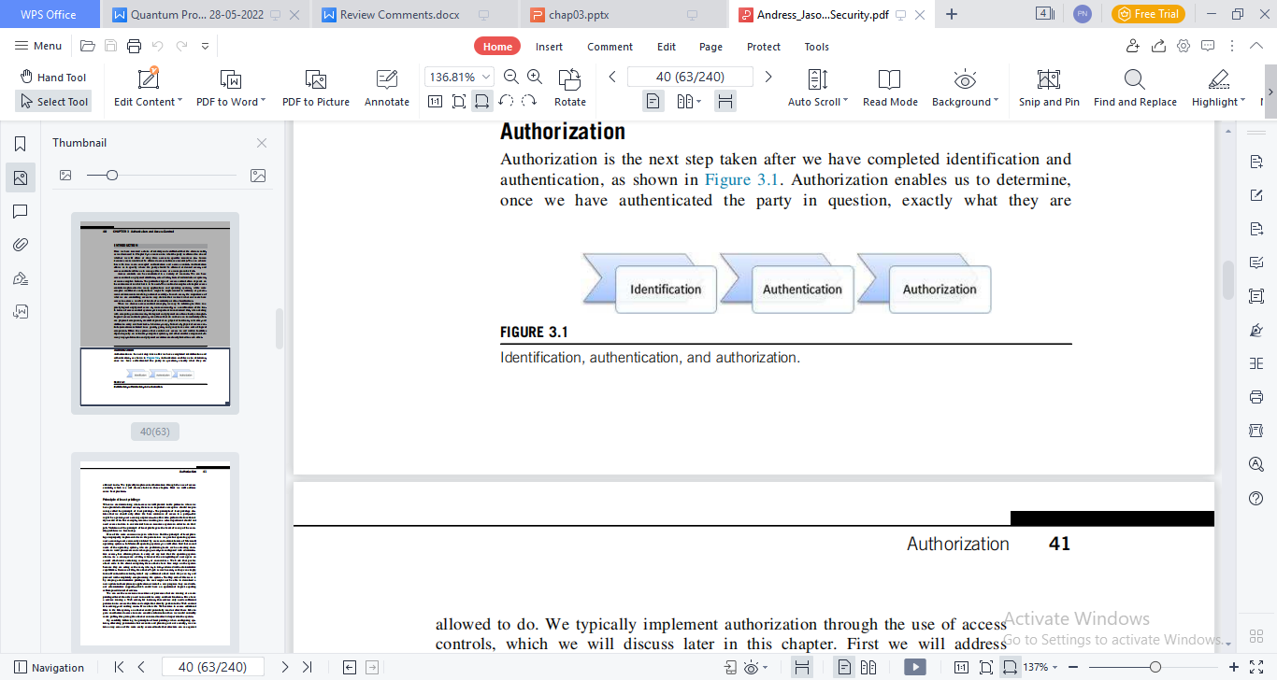
AUTHORIZATION
Authorization is the next step taken after we have completed identification and authentication.
Authorization enables us to determine, once we have authenticated the party in question, exactly what they are allowed to do.
We typically implement authorization through the use of access controls.

Slide 10
PRINCIPLE OF LEAST PRIVILEGE
When we are determining what access we will provide to the parties to whom we have provided authorized access, there is an important concept we should keep in mind, called the principle of least privilege.
The principle of least privilege dictates that we should only allow the bare minimum of access to a party—this might be a person, user account, or process—to allow it to perform the functionality needed of it.

Slide 11
PRINCIPLE OF LEAST PRIVILEGE
For example, someone working in a sales department should not need access to data in our internal human resources system in order to do their job.
Violation of the principle of least privilege is the heart of many of the security problems we face today.

Slide 12
ACCESS CONTROL
As a consequence of this, whenever the over-privileged user opens an e-mail attachment containing malware, or encounters a Web site that pushes attack code to the client computer, these attacks have free reign on the system because they are acting as the user, who is, in turn, endowed with administrative capabilities

Slide 13
ACCESS CONTROL
Because of this, the attacker’s job is much easier, as they can simply turn off anti-malware tools, install any additional attack tools they can to, and proceed with completely compromising the system.
The flip side of this issue is by denying administrative privileges the user might not be able to download a new update to their primary application or install a new program they need without administrative support—which could have an operational impact equaling self-imposed denial of service.

Slide 14
ACCESS CONTROL
When we look at access controls, we have four basics tasks we might want to carry out:
Allowing access
Denying access
Limiting access, and
Revoking access.

Slide 15
ACCESS CONTROL
Allowing access lets us give a particular party, or parties, access to a given resource.
Denying access is simply the opposite of granting access.
When we deny access, we are preventing access by a given party to the resource in question.

Slide 16
ACCESS CONTROL
Limiting access refers to allowing some access to our resource, but only up to a certain point.
Revocation of access is a very important idea in access control.
It is vital that once we have given a party access to a resource, we be able to take that access away again.

Slide 17
ACCESS CONTROL
If we were, for instance, to fire an employee, we would want to revoke any accesses that they might have.
We would want to remove access to their e-mail account, disallow them from connecting to our Virtual Private Network (VPN), deactivate their badge so that they can no longer enter the facility, and revoke other accesses that they might have.

Slide 18
ACCESS CONTROL
When working with computer-oriented resources, it may be vital to be able to revoke access to a given resource very quickly, thus necessitating good coordination between HR and IT in termination cases.
When we look to implement access controls, there are two main methods that we might use:
Access control lists and
Capabilities
Each of these has positives and negatives, and the ways we can carry out the four basic tasks we covered earlier will differ depending on the method we choose for our access control implementation.

Slide 19
ACCESS CONTROL LISTS
Access control lists (ACLs), often referred to as “ackles,” are a very common choice of access control implementation.
ACLs are usually used to control access in the file systems on which our operating systems run
ACLs is used to control the flow of traffic in the networks to which our systems are attached.

Slide 20
ACCESS CONTROL LISTS
ACLs are most commonly discussed in the context of firewalls and routers.
When ACLs are constructed, they are typically built specifically to a certain resource
They contain the identifiers of the party allowed to access the resource in question and what the party is allowed to do in relation to the resource.

Slide 21
FILE SYSTEM ACLS
When we look at the ACLs in most file systems, we commonly see three permissions in use:
read
write, and
execute, respectively
Allowing us to access the contents of a file or directory, write to a file or directory, and, presuming that a file contains either a program or a script capable of running on the system in question.

Slide 22
ACCESS CONTROL METHODOLOGIES
Access controls are the means by which we implement authorization and deny or allow access to parties, based on what resources we have determined they should be allowed access to.
Although the term may sound very technical and oriented in the direction of high-security computing facilities, access controls are something we deal with on a daily basis.
When we lock or unlock the doors on our house, we are using a form of physical access control, based on the keys (something you have) that we use.

Slide 23
ACCESS CONTROL METHODOLOGIES
When we start our car, we are also likely to use a key.
For some newer cars, our key may even include an extra layer of security by adding Radio Frequency Identification (RFID) tags, certificate-like identifiers stored on the key itself, and other security technologies.

Slide 24
ACCESS CONTROL METHODOLOGIES
Upon reaching our place of employment, we might use a badge or key (something you have) to enter the building, once again, a physical access control.
When we sit down in front of our computer at work and type in our password (something you know), we are authenticating and using a logical access control system in order to access the resources to which we have been given permission.

Slide 25
ACCESS CONTROL MODELS
Discretionary access control: A model of access control based on access being determined by the owner of the resource in question. The owner of the resource can decide who does and does not have access, and exactly what access they are allowed to have.
Mandatory access control: A model of access control in which the owner of the resource does not get to decide who gets to access it, but instead access is decided by a group or individual who has the authority to set access on resources.

Slide 26
ACCESS CONTROL MODELS
Role-based access control: A model of access control that, similar to MAC, functions on access controls set by an authority responsible for doing so rather than by the owner of the resource. The difference between RBAC and MAC is that access control in RBAC is based on the role the individual being granted access is performing.
Attribute-based access control: Attribute-based access control (ABAC) is, logically, based on attributes. These can be the attributes of a particular person, of a resource, or of an environment.

Slide 27
ACCESS CONTROL MODELS
Multilevel access control: Multilevel access control models are used where the simpler access control model that we just discussed are considered to not be robust enough to protect the information to which we are controlling access.
Physical access controls: When concerned with physical access controls, we are often largely concerned with controlling the access of individuals and vehicles. Access control for individuals often revolves around controlling movement into and out of buildings or facilities.

Slide 28
Authorization and access control in the real world
We can see authorization and access control used in our personal and business lives on an almost constant basis, although the portions of these that are immediately visible to us are the access controls.
Looking specifically at logical access controls, we can see them used when we log in to computers or applications, when we send traffic over the Internet, when we watch cable or satellite television, when we make a call on our mobile phones, and in thousands of other places.

Slide 29
Authorization and access control in the real world
In some cases, such measures are visible to us and require us to enter a password or a PIN, but a large portion of them happen in the background, completely invisible to the tasks we are carrying out and taken care of by the technologies that facilitate our tasks.

Slide 30
Authorization and access control in the real world
In the sense of physical access controls, we see these rather frequently as well, although it may not register to us that we are seeing them.
Most of us carry around a set of keys that allow us access to our homes, cars, and other devices, and these are the credentials for access to them.

Slide 31
Authorization and access control in the real world
Many of us also carry proximity badges that allow us access to our places of employment, schools, and in case of driver’s license places like bars.
We can also see the access controls that manage the movement of vehicles in everyday use in vehicle-oriented areas such as parking garages and parking areas at airports, and in the vicinity of high-security areas such as the White House in the United States.

Slide 32
THANK YOU

